Slide 1
The John Paul Experience
John Paul Pennisi
William Matrix Peckham
Chris Scarola
Thomas Beigner

Slide 2
Design Choices
Client-Server applications
All members much more familiar with swing than with web applications
Seemed to be easier to code
Sockets for communication
Swing for GUI

Slide 3
More Design Choices
Java will be used for development with Netbeans or Eclipse as the IDE
JPA and JDBC for Administrator login IDs, passwords, as well as courses and requirements

Slide 4
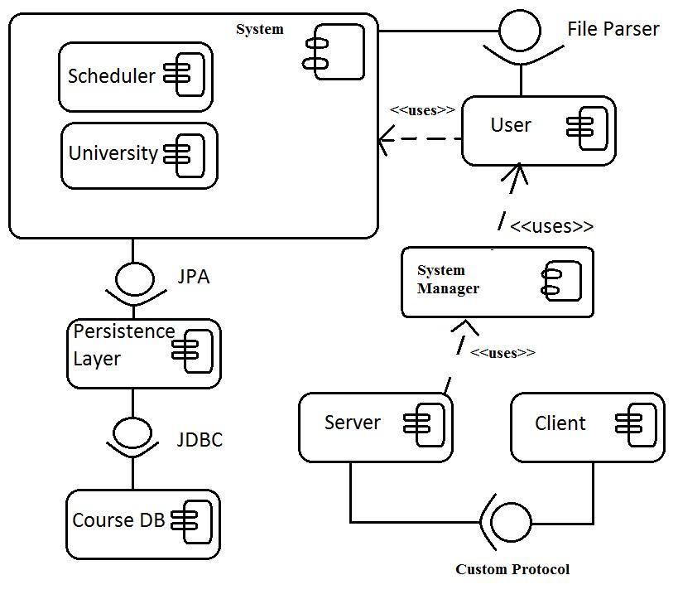
Components

Slide 5
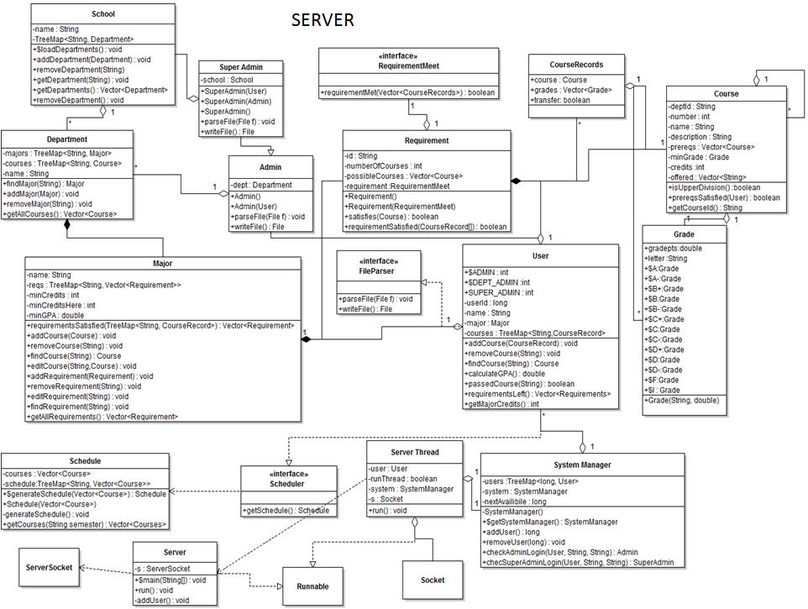
Server Class Diagram

Slide 6
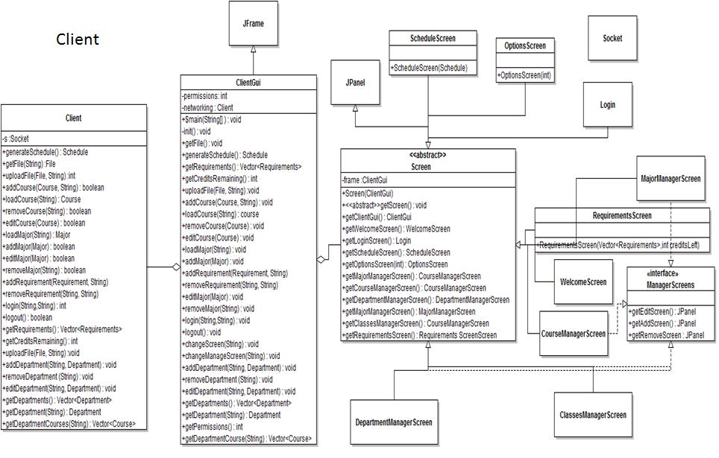

Slide 7
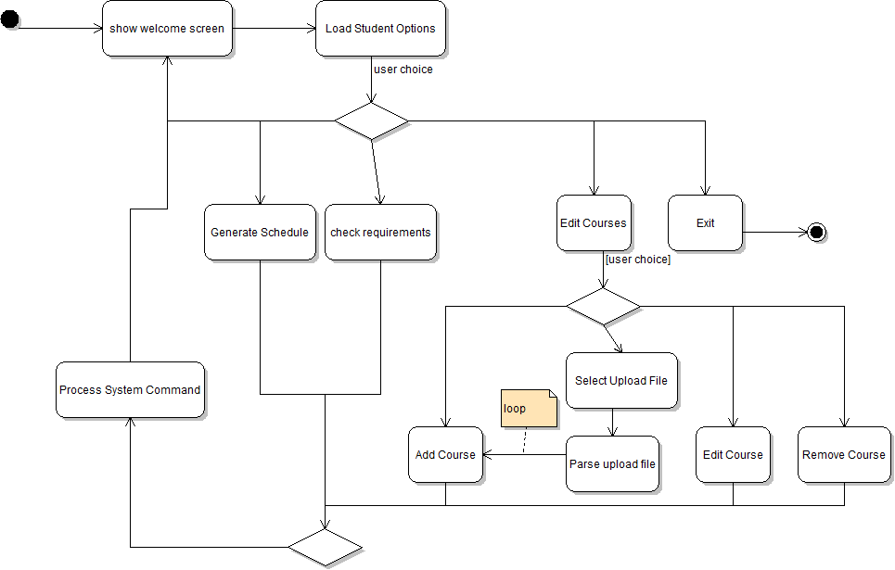
Student Activity Diagram

Slide 8
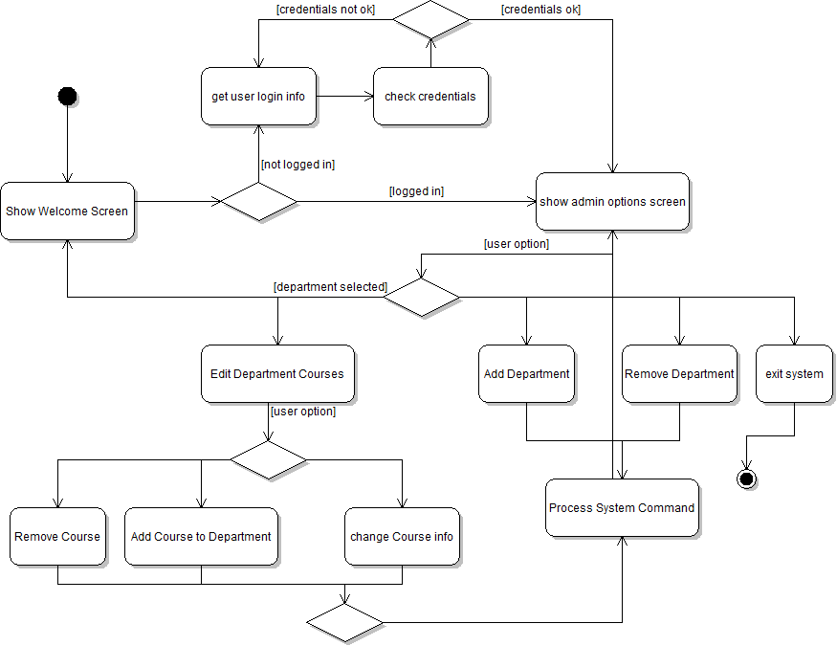
Registrar Admin Activity Diagram

Slide 9
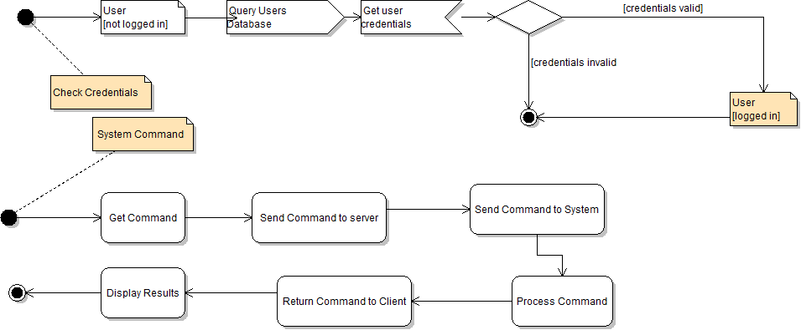
Activity Sub-diagrams

Slide 10
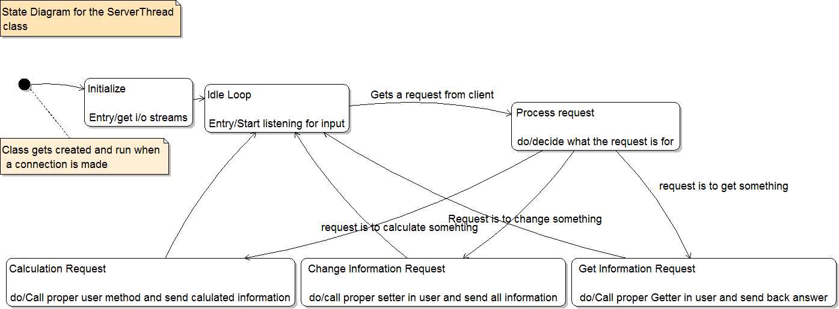
Server Thread State Diagram

Slide 11
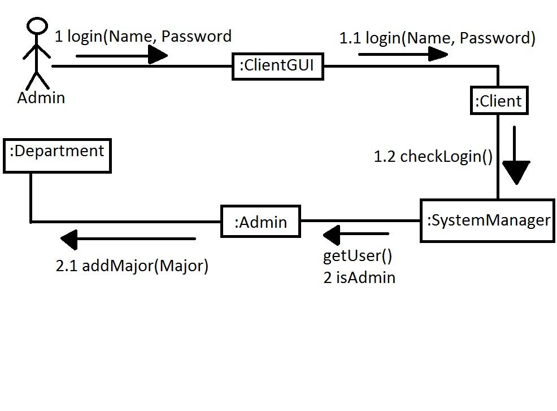
Admin Communication Diagram

Slide 12
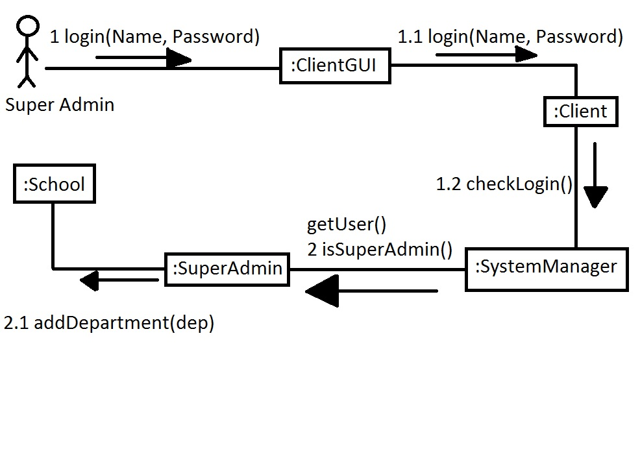
Super Admin Communication Diagram

Slide 13
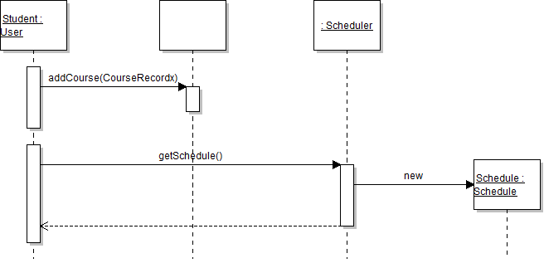
Student Generate Schedule Sequence Diagram

Slide 14
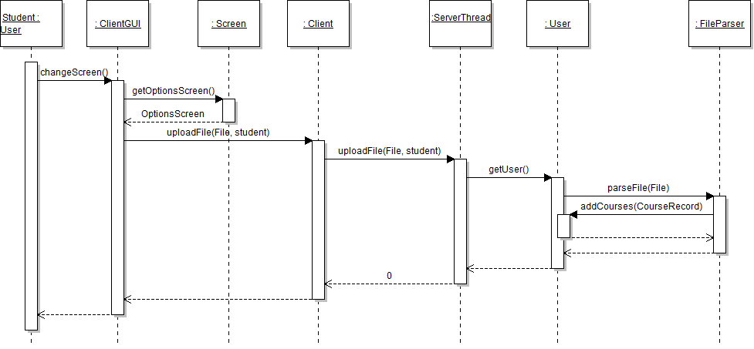
Student Upload Sequence Diagram

Slide 15
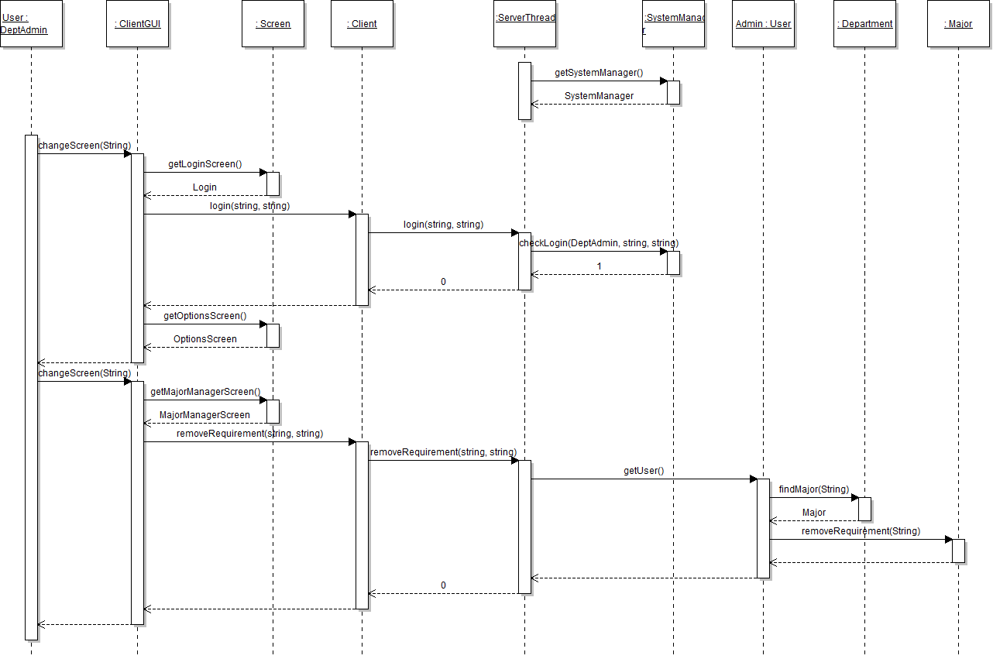
Admin Sequence Diagram

Slide 16
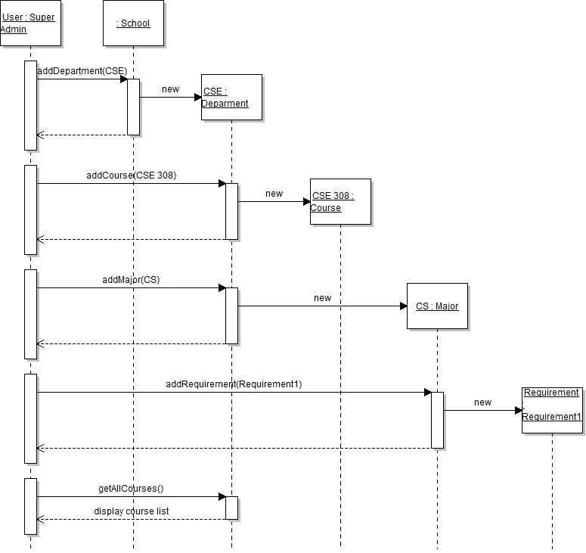
Super Admin Sequence Diagram

